Slide 1
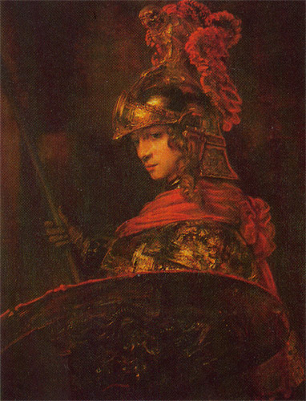
Introducing Alexander
The Greatest Greek of All

Slide 2
Think/Pair/Share
What do you know/think/believe/suspect about Alexander the Great?

